Slide 1
AWS DevOps
Code Pipeline , Code Commit , Code Build , Code Deploy – ECS Farget

Slide 2
Contents
Architecture Diagram
Code Pipeline
Code Commit
Code Build
Code Deploy
ECS Farget
Future Enhancement

Slide 3
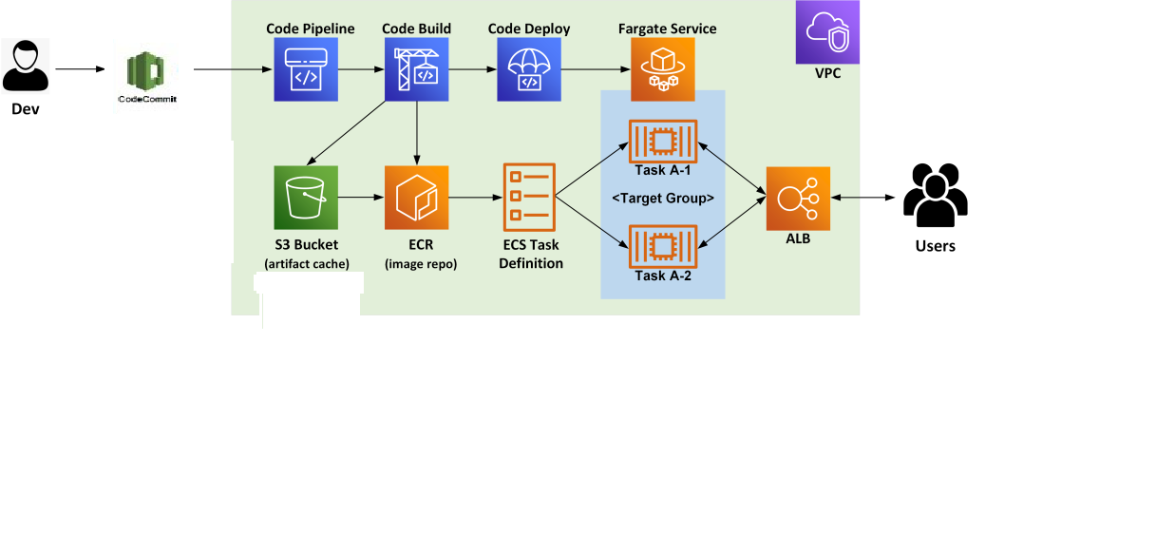
Architecture Diagram

Slide 4
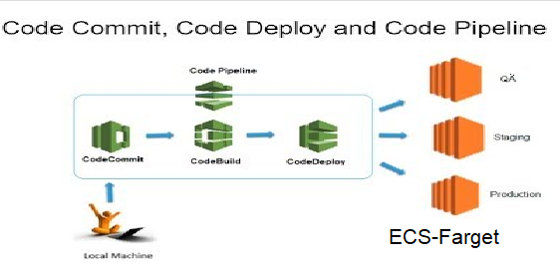
Code Pipeline

Slide 5
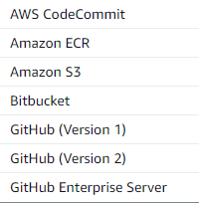
Alternatives
Source Provider

Slide 6
Build Stage
AWS Code Build
Jenkins

Slide 7
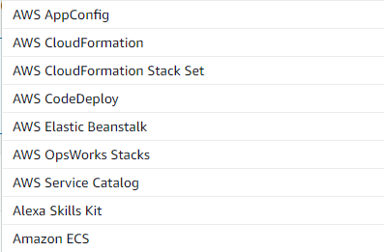
Deploy Stage

Slide 8
Future Enhancements
IAM User and Policy to restrict access to specific pipeline
AWS DevSecOps
Code Guru
AWS Inspector
EKS - Farget
Dashboards
Cloud Watch
AWS Quicksight

